Slide 1
Innovation in UX/UI
Tech Laboratory 2

Slide 2
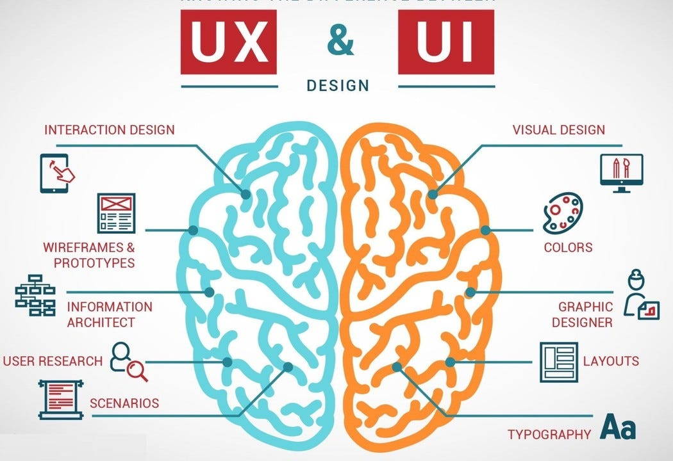
UX vs UI
UX (user experience designer) focuses on all aspects of the USER's interaction with the company, its services, and its products.
UI (user interface designer) is a specialized UX
UI focus: visuals interaction
*https://miro.medium.com/v2/resize:fit:1050/1*hp-yfKsmzsj711iLbM8eEw.jpeg

Slide 3
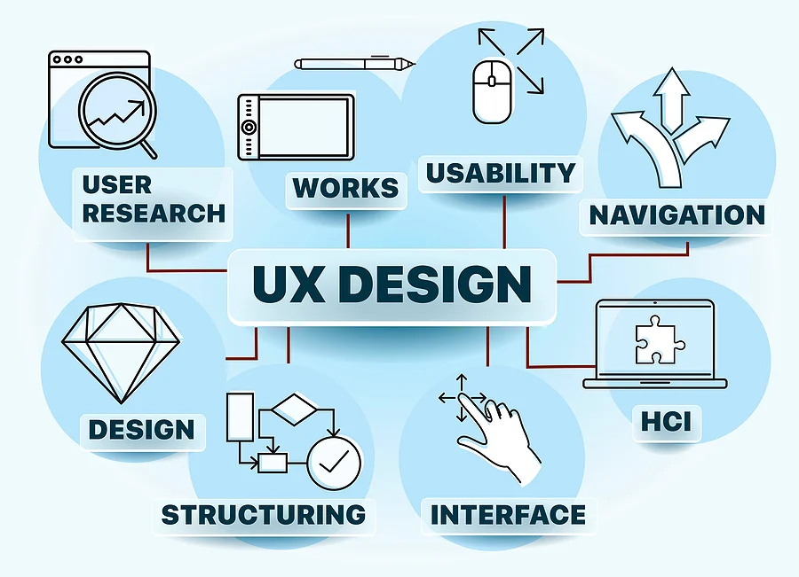
UX
Task and responsibilities:
Strategy and content
Wireframing and prototyping
Execution and analysis
*https://www.keenesystems.com/hs-fs/hubfs/blog-images/ux-design.jpg?width=900&name=ux-design.jpg

Slide 4
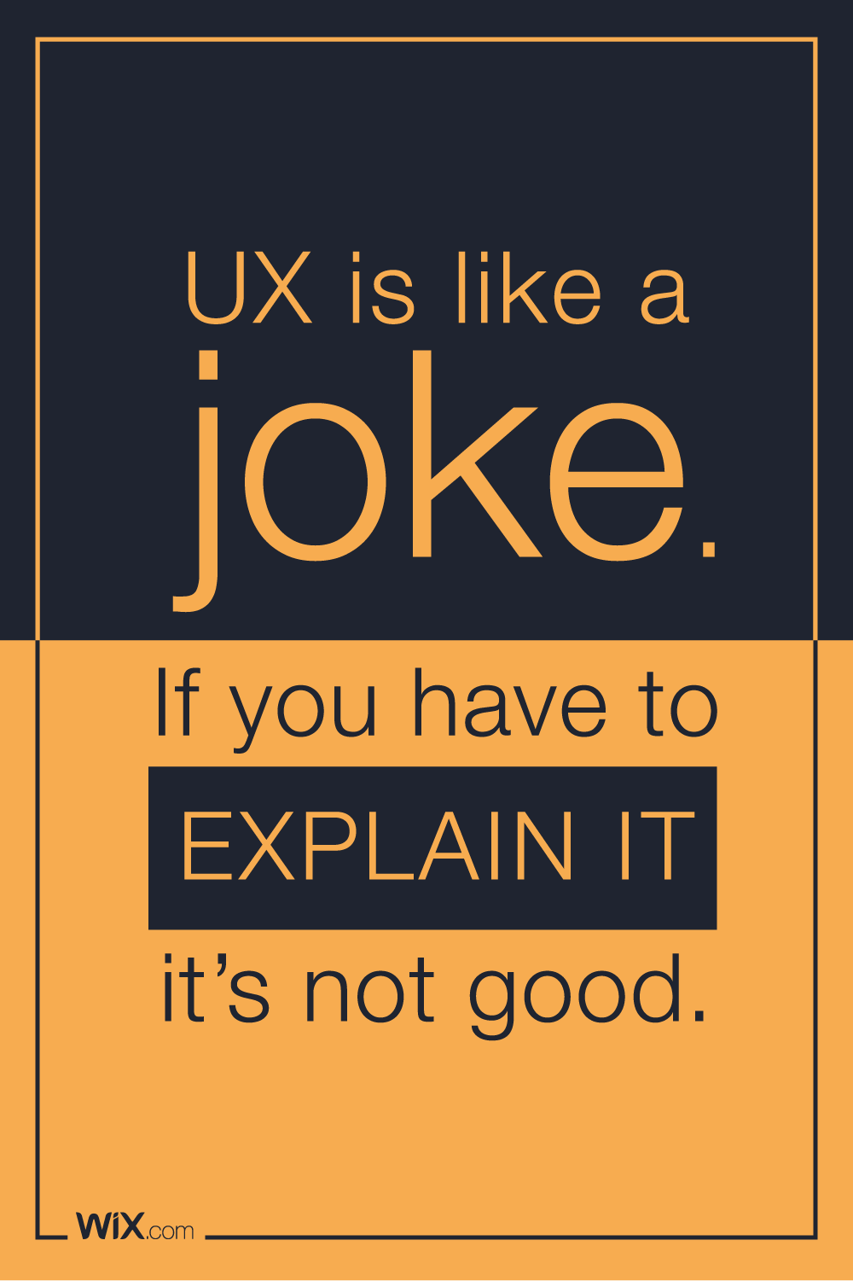
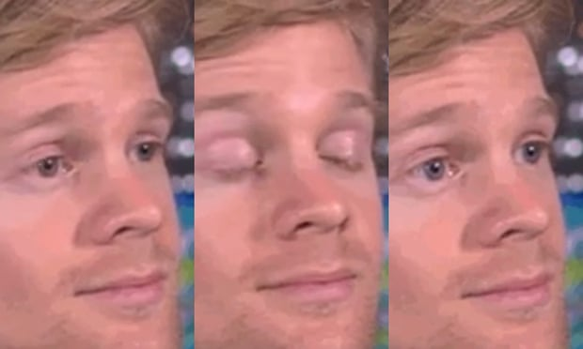
Understanding Good UX: An Important Truth
Image: https://webdesignledger.com/35-design-jokes-will-make-you-laugh/

Slide 5
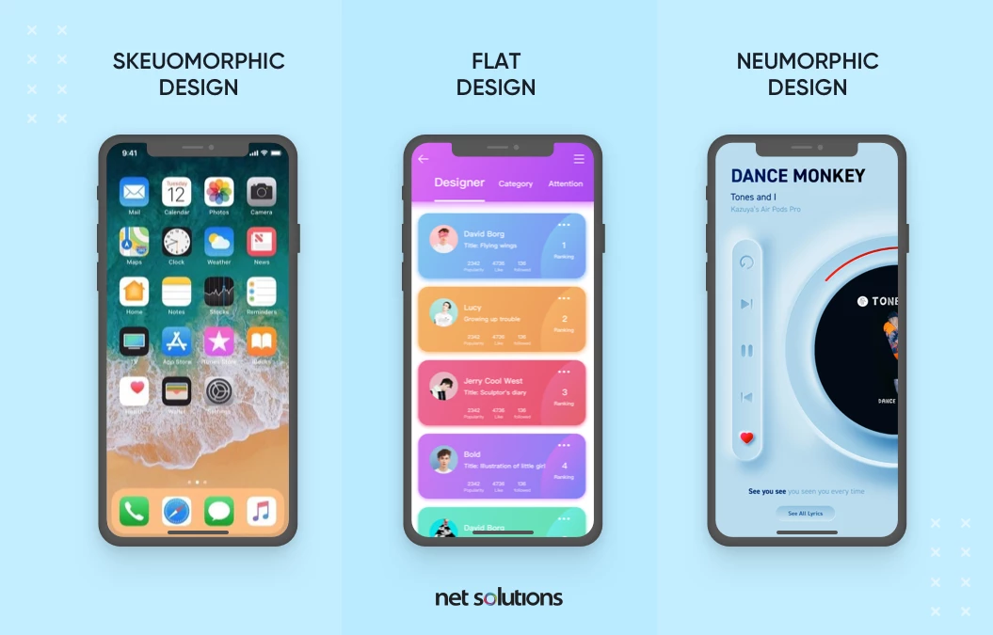
UI
Task and responsibilities:
The look and feel of the product
Responsiveness and interactivity
https://www.netsolutions.com/insights/wp-content/uploads/2022/02/neumorphism.webp

Slide 6

10 Usability Heuristics for User Interface Design Nielsen Norman Group Ph.D Donald Norman - former VP of research @ Apple Ph.D Jakob Neilsen – 79 US patents, making the internet easier to use
*https://www.nngroup.com/articles/ten-usability-heuristics/

Slide 7

Let's Play a Game: Good UX vs. Bad UX
Notes:
For the next section, I'm going to show you examples from real apps. Your job is to tell me which one provides a better experience, and more importantly, why

Slide 8
Theme 1: The Foundation - Clarity & User Confidence
Heuristics #1, #2, and #4

Slide 9
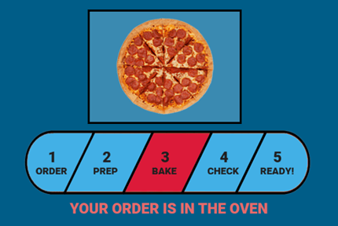
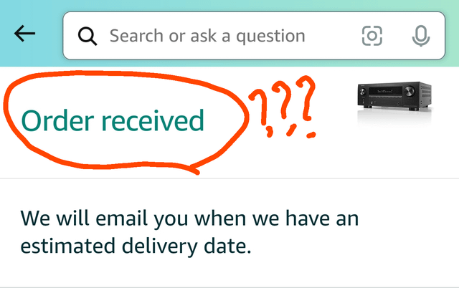
<- Left or right ? ->
Notes:
Which of these makes you feel more confident and less anxious about your order? Why?

Slide 10
Heuristic #1: Visibility of System Status
Great UX always keeps the user informed.

Slide 11
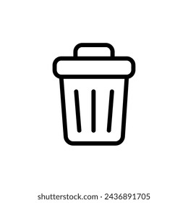

Which icon do you understand immediately without thinking?

Slide 12
#2: Match Between System and the Real World
The system should speak the users' language and use familiar conventions.

Slide 13
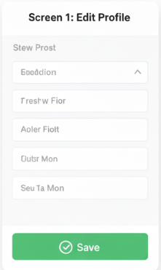
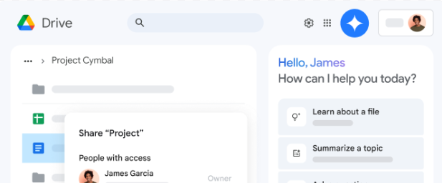
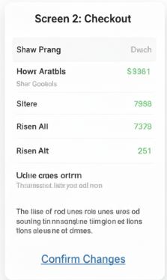
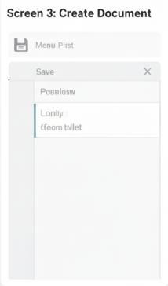
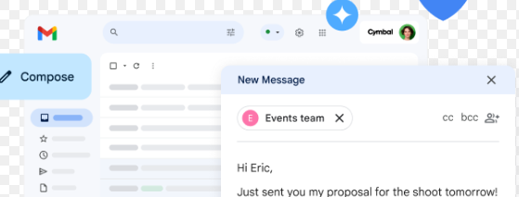
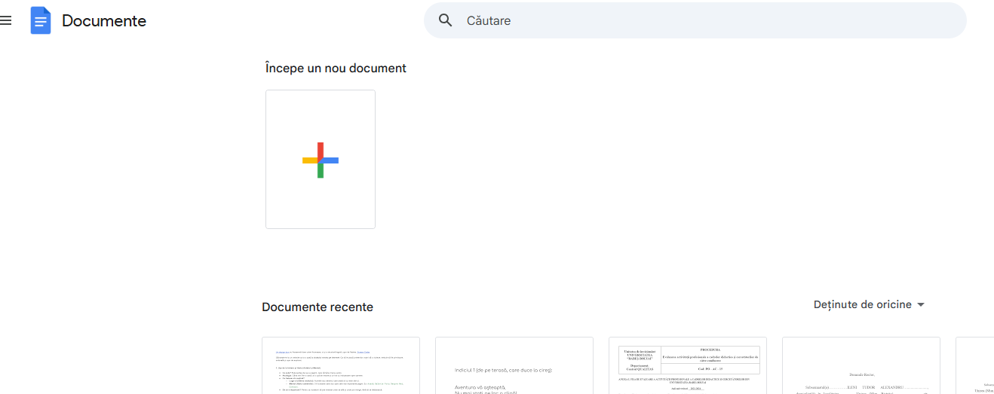
The Power of Patterns
Notes:
What suits of app make you navigate seamless between them, and what app would feel confusing and mentally tiring?

Slide 14
Heuristic #4: Consistency and Standards
Users should never have to wonder if different words, icons mean the same thing
Internal Consistency: The Google Workspace
External Consistency: following platform and industry conventions - green for environment, blue for airplane

Slide 15
Theme 2: The Safety Net - Forgiveness & Error Handling
Heuristics #3, #5, #9 and #10

Slide 16
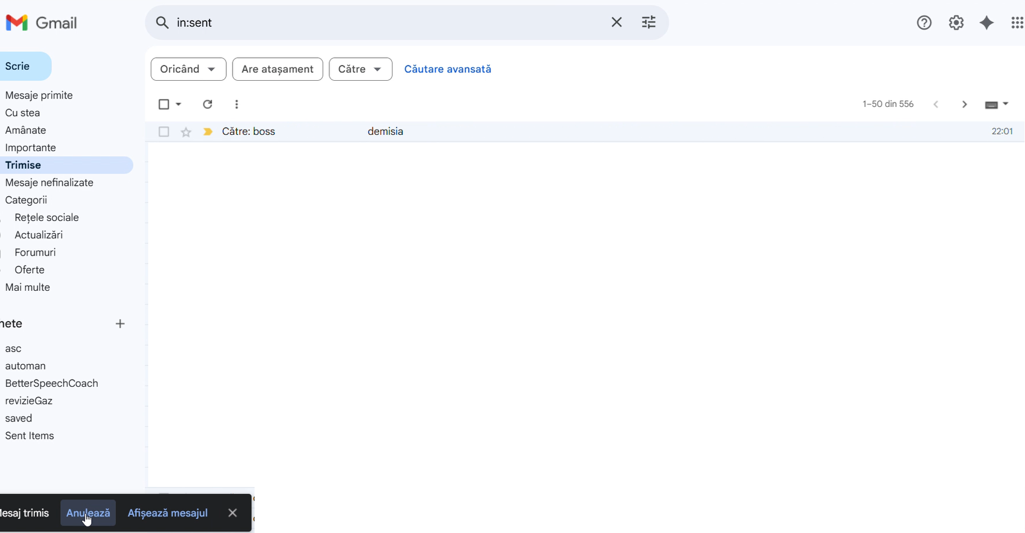
Why is this one of the most beloved features?

Slide 17
Heuristic #3: User Control and Freedom
Users need a clear 'emergency exit' to leave an unwanted state
'Undo' is the ultimate safety net.

Slide 18
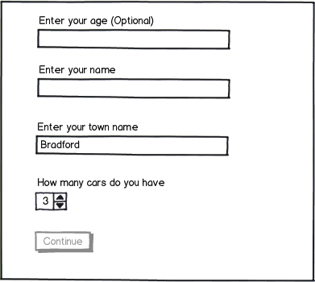
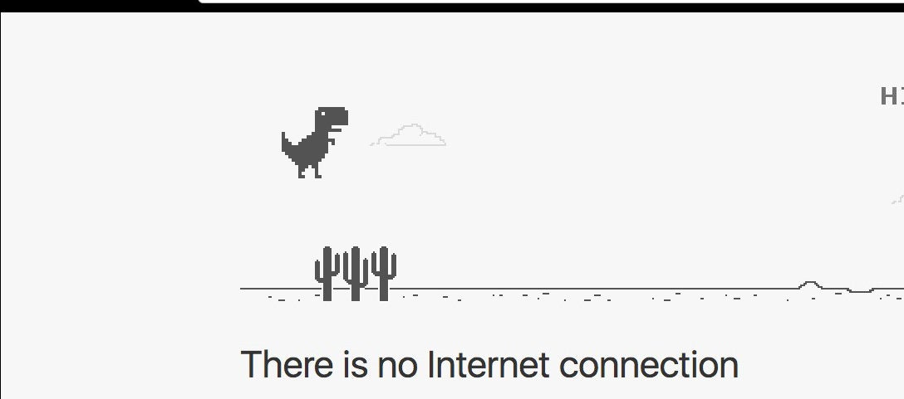
Error Prevention vs. Recovery
Notes:
Include Helpful Constraints e.g. date picker
Offer Suggestions e.g. on search
Choose Good Defaults e.g. location, today date
Use Forgiving Formatting e.g. phone number
Use traditional error-messages visuals, like bold, red text
Tell users what went wrong in language they understand
Offer users a solution, like a shortcut that can solve the error immediately.

Slide 19
Heuristic #5: Error Prevention
making it impossible to fail
Heuristic #9: Help Users Recover from Errors
making the failure state less frustrating, understandable and even fun

Slide 20
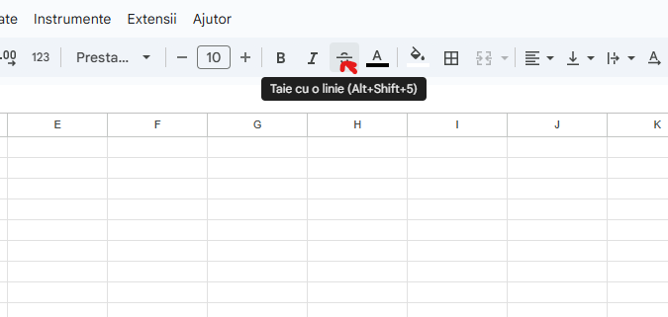
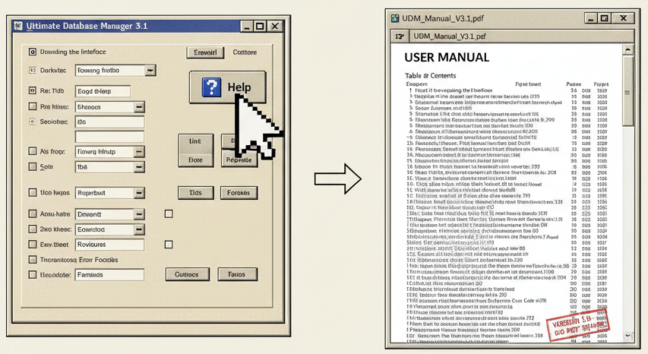
When All Else Fails, Read the (Right) Manual!

Slide 21
Heuristic #10: Help and Documentation
Even the best systems need good help, but how that help is delivered makes all the difference
Notes:
Whenever possible, present the documentation in context right at the moment that the user requires it.
Proactive help:
tutorials
instruction overlays
tooltips
wizards

Slide 22
Theme 3: The Accelerator - Efficiency & Elegance
Heuristics #6, #7, and #8

Slide 23
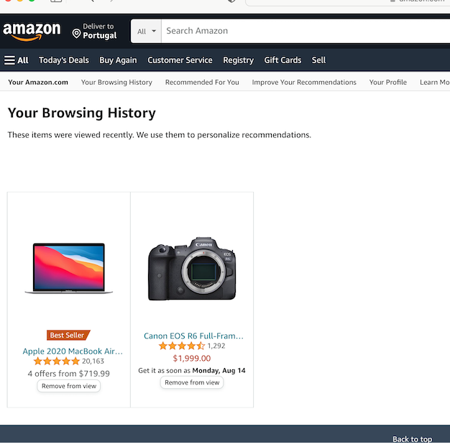
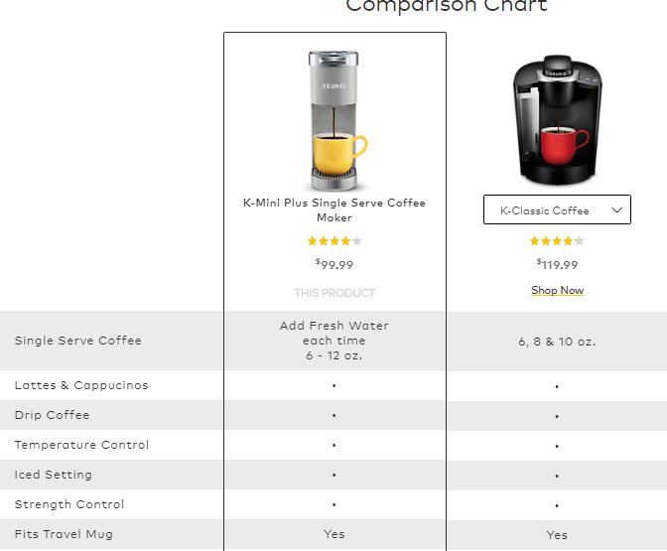
Why are those sections so effective?
Notes:
Reduce the information that users have to remember.
Offer help in context, instead of giving users a long tutorial to memorize.

Slide 24
Heuristic #6: Recognition Rather Than Recall
It's easier for us to recognize something we've seen before than to recall it from scratch

Slide 25
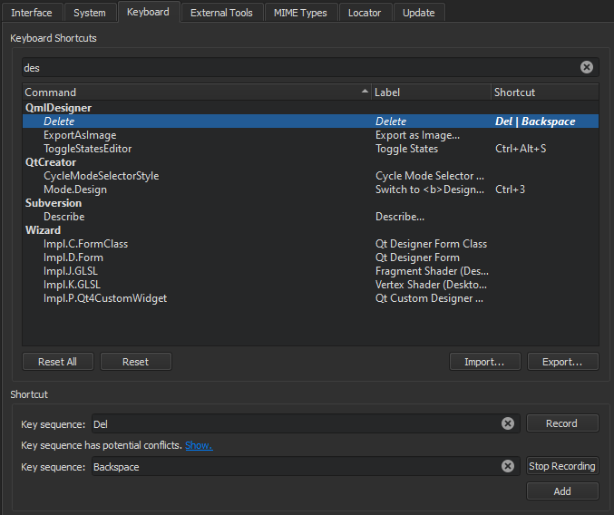
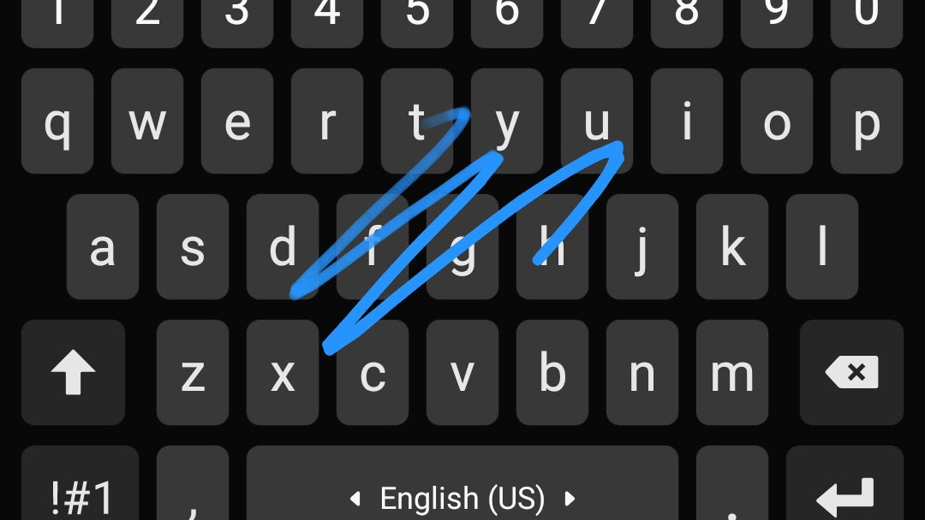
Power to the People! (and the Pros)

Slide 26
#7: Flexibility and Efficiency of Use
A great system caters to both inexperienced users and experienced experts."
Notes:
For Novices: "New users need clear, step-by-step guidance. They benefit from obvious buttons, clear labels, and intuitive workflows.
For Experts: "Experienced users want to perform tasks quickly. They benefit from accelerators like keyboard shortcuts, customizable settings

Slide 27
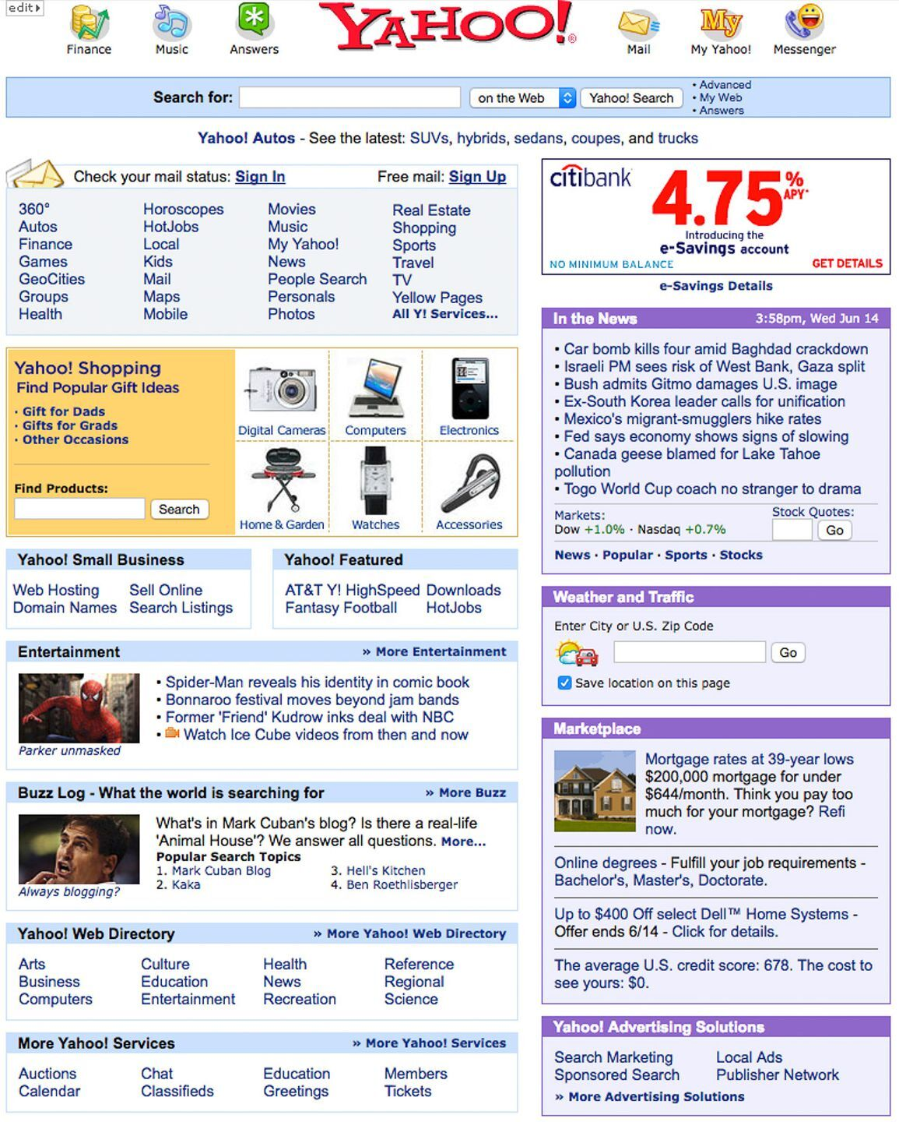
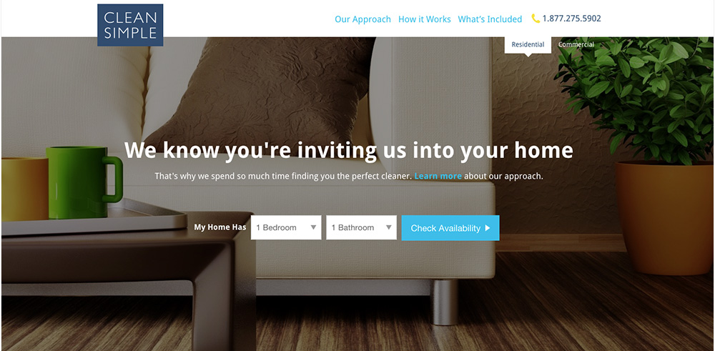
Which page lets you accomplish your goal faster?

Slide 28
Heuristic #8: Aesthetic and Minimalist Design
Every extra piece of information competes with the relevant information.
Notes:
scale: use relative size to signal importance
visual hierarchy: color, spacing, placement

Slide 29
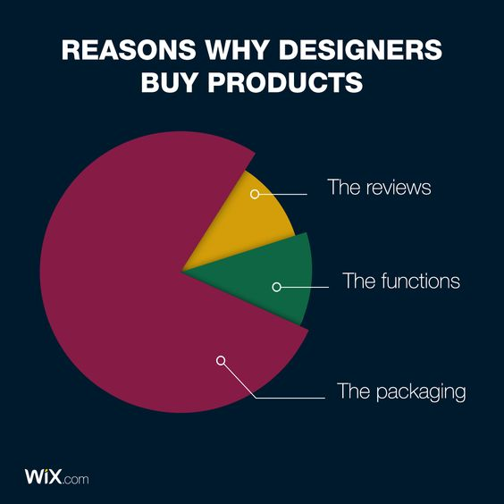
Relevance when buying something
maybe for all of us...

Slide 30
Milestone 2 (Eng: week 5, Ro: week 6)
Theme: To immediately begin development on the real MVP by creating the primary user interface and simulating the backend logic.
Tasks:
UI Development: Develop the main screens for your MVP as a native mobile or web application. The design should be clean and functional, implementing the core user flow needed to test your innovation.
CRUD Implementation: Implement the core user actions that allow users to Create, Read, Update, and Delete the main elements of your app. Your app may not need all four operations; implement what is necessary for your MVP's core loop.
Mocked Data & Logic: The application does not need to connect to a real database or a trained model yet.
For data, use hardcoded, in-memory lists or arrays to populate the UI.
If your app has an AI component, the function that should call the model can return a hardcoded or random response that mimics the real output format.
Deliverable: A link to your project's code repository (e.g., GitHub) AND (a short video (1-2 minutes) demonstrating the functional UI, OR screen shots from app)

Slide 31
References
https://www.nngroup.com/articles/ten-usability-heuristics/
https://www.nngroup.com/videos/you-are-not-user-slogan/
https://careerfoundry.com/en/blog/ux-design/the-difference-between-ux-and-ui-design-a-laymans-guide/
https://www.youtube.com/watch?v=1jtQ0uIIs94

